Slide 1
Hierarchical Heterogeneous Graph Representation Learning
for Short Text Classification
Yaqing Wang, Song Wang, Quanming Yao, Dejing Dou
Baidu Research, Baidu Inc., China
Department of ECE, University of Virginia, USA
Department of EE, Tsinghua University, China
EMNLP 2021
Code: https://github.com/tata1661/SHINE-EMNLP21.
Zhuomin Chen
2022.02.15

Slide 2
Introduction
Two Key Issues:
1. Short texts only contain one or a few sentences whose overall length is small, which lack enough context information and strict syntactic structure to understand the meaning of texts.
"Birthday girl is an amusing ride": "Birthday girl" is a 2001 movie.
"how much Tesla": Does not contain word order nor function words.
2. Real STC tasks usually only have a limited number of labeled data compared to the abundant unlabeled short texts emerging everyday.

Slide 3
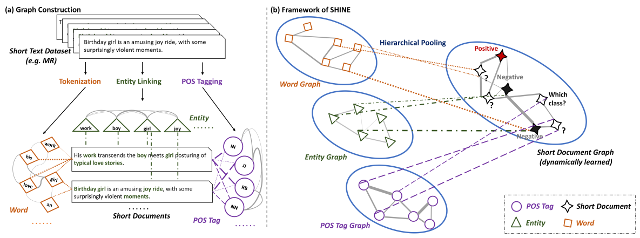
Methodology

Slide 4
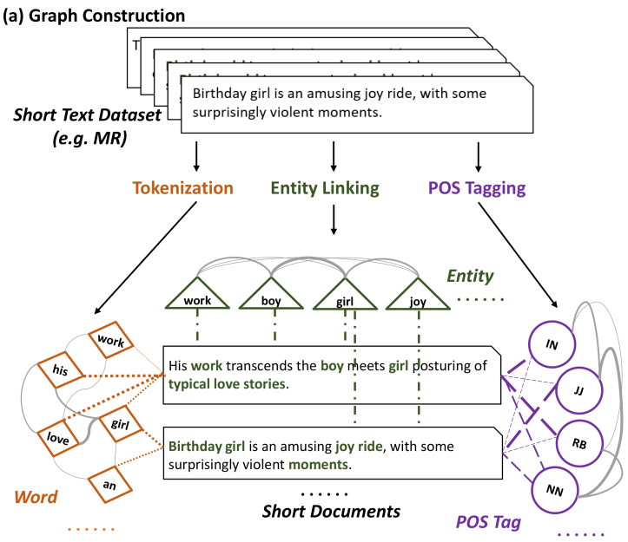
Word-Level Component Graphs
Node Embedding Learning
Three types of word-level components:
word (w); POS tag (p); entity (e)

Slide 5
Word-Level Component Graphs
Graph Construction
PMI denotes the point-wise mutual information between
words

Slide 6
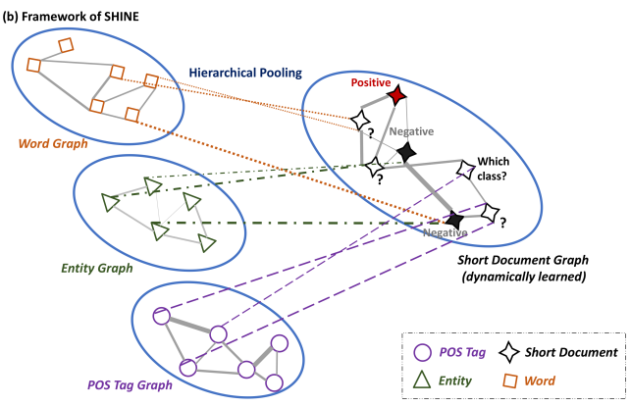
Short Document Graph
The short document graph:

Slide 7
Short Document Graph

Slide 8
Experiments

Slide 9
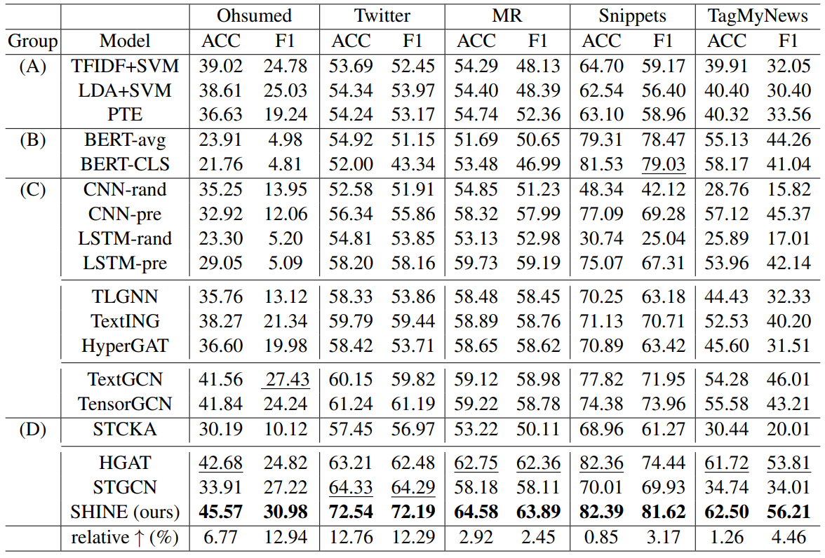

Slide 10
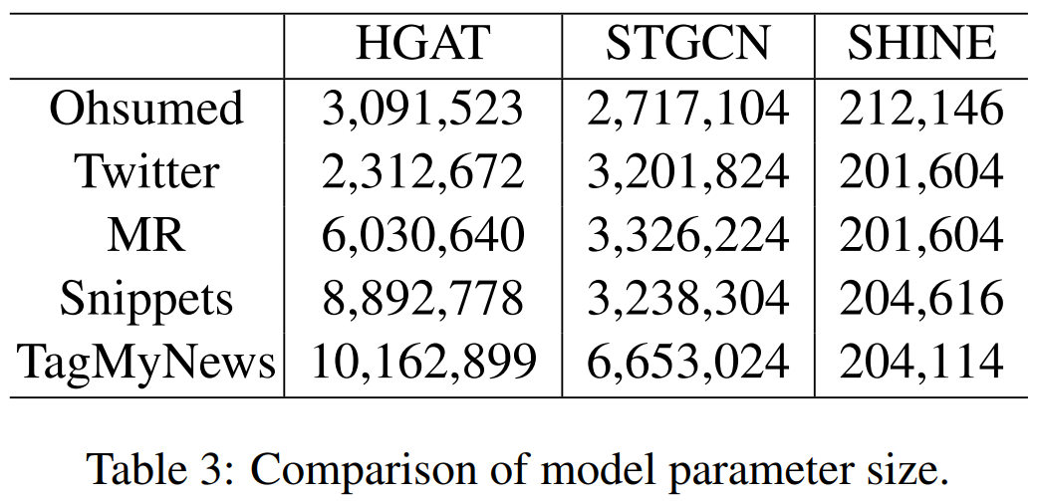

Slide 11
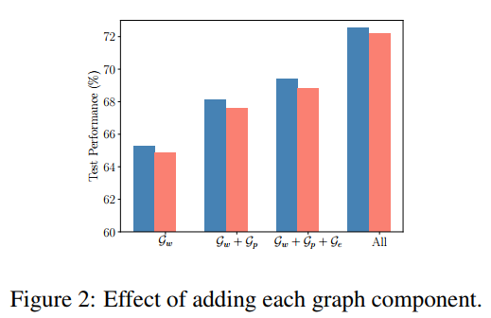

Slide 12
